Slide 1




Lariat
Rent-A-Car Analysis
Johnson Liang

Slide 2
Contents
1
2
Our Business Goal
Market and Company Overview
3
4
Strategies
Final Recommendations

Slide 3
Business Goal
1
REDUCE COSTS
INCREASE REVENUE

Slide 4

Market Overview
2
Global Market Cap of $85B
North America!
5% Growth over 5 years

Slide 5

Company Overview
3
4000 Cars in Fleet
81,318 Rentals
$19.75M Net Profit
325,608 Days

Slide 6
Strategies
4

Slide 7
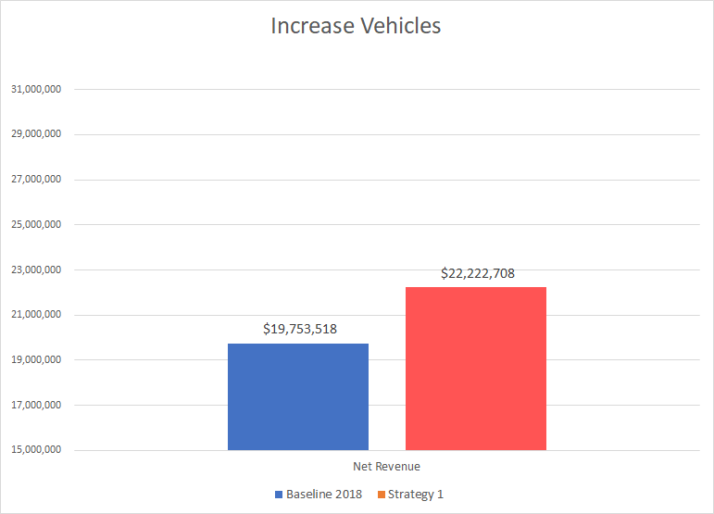
Strategy 1: Increase Vehicles!
5
Our model used a 500 vehicle increase
Net gain of $2.5M

Slide 8
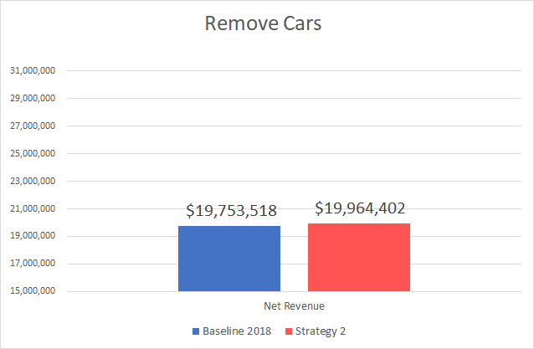
Strategy 2: Remove Bad
Vehicles!
6
We are removing vehicles that are costing money
Net gain of approx. $200,000

Slide 9
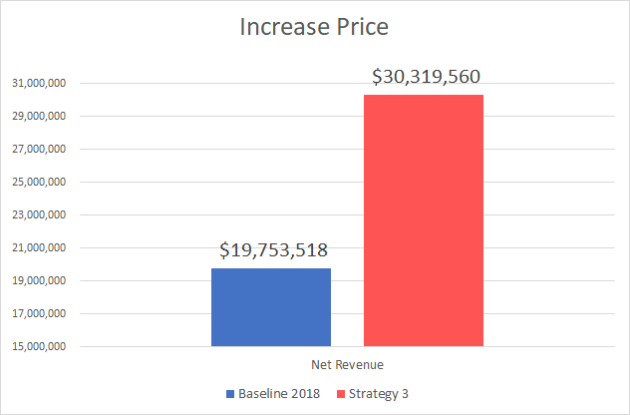
Strategy 3: Increase Price!
7
Increase Average Daily Rental Price by 20%
$162 to $195
Net Gain of approx. $10.5M

Slide 10
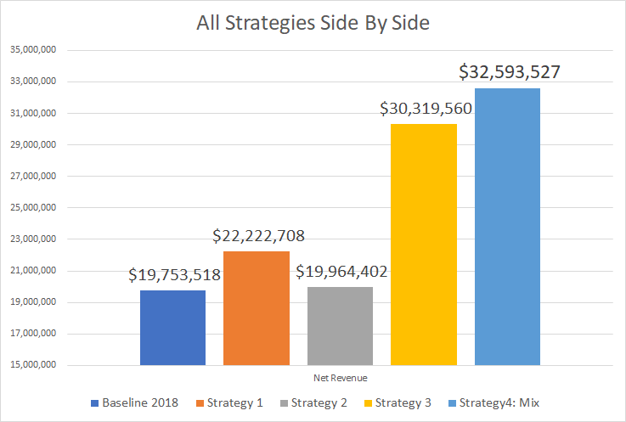
Final Recommendations
8
Combine all 3 previous strategies
Net gain of $12.8M
Research potential markets, expand branches in certain states, and even expand on to new states

Slide 11
Reference
10
https://www.mordorintelligence.com/industry-reports/car-rental-market

Slide 12
Thank You!
9

